Slide 1
Data Science with Python and Pandas
Dylan Gregersen
gregersen.dylan@gmail.com

Slide 2


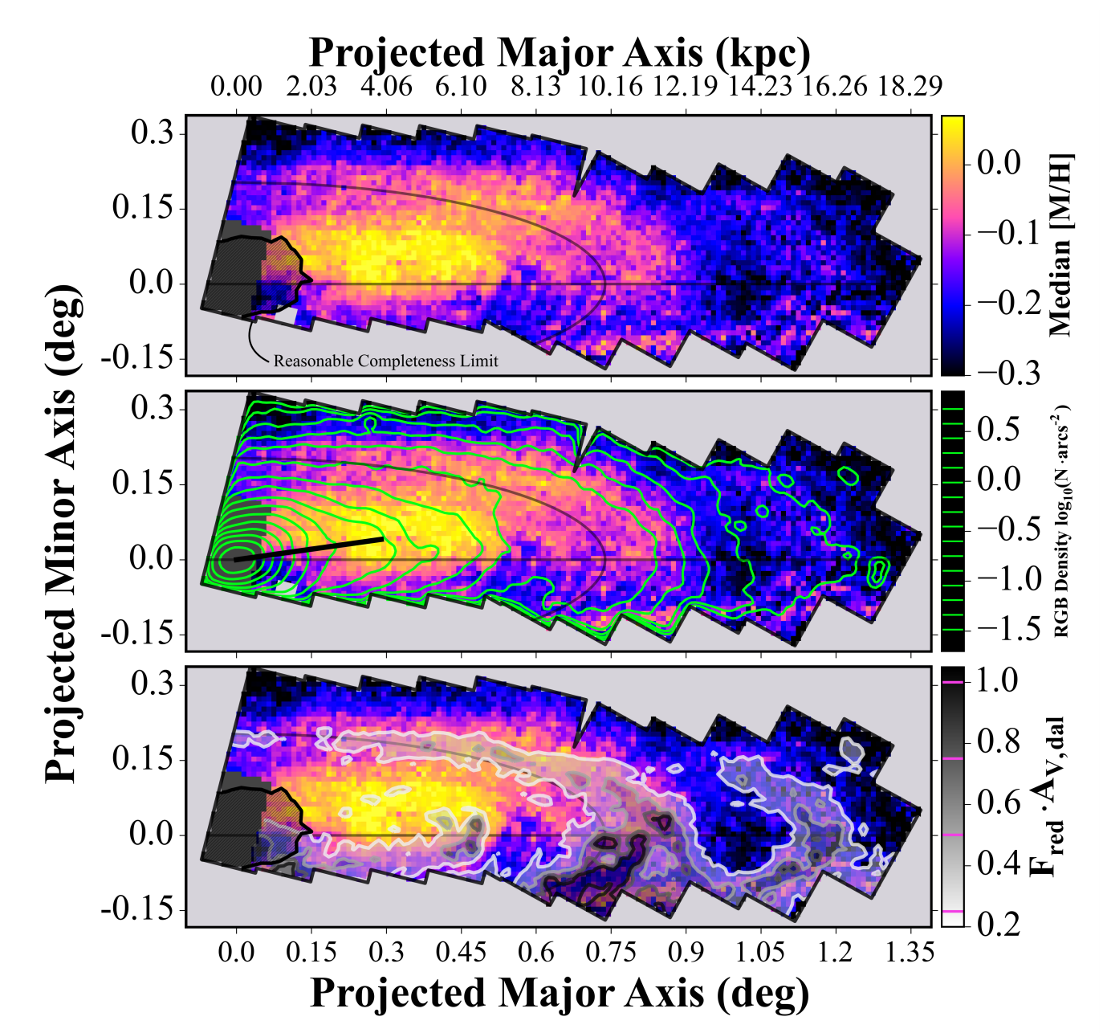
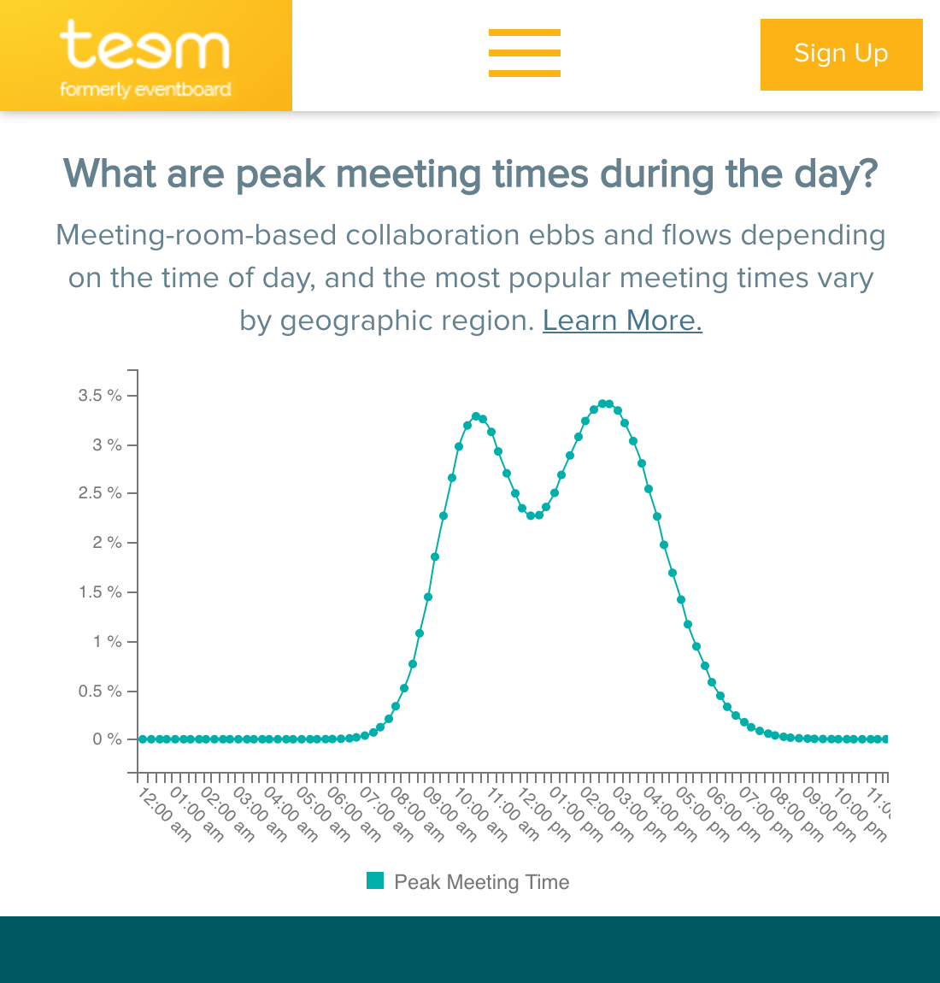
About Me
My name is Dylan Gregersen
I have a degree in Physics and published research in Astronomy
I currently work at Teem as a Data Scientist and Python Dev
I love getting outside by skiing, kayaking or hiking. I’m also progressing to a swing dance king!
gregersen.dylan@gmail.com
astrodsg.github.io

Slide 3
What is Data Science?

Slide 4
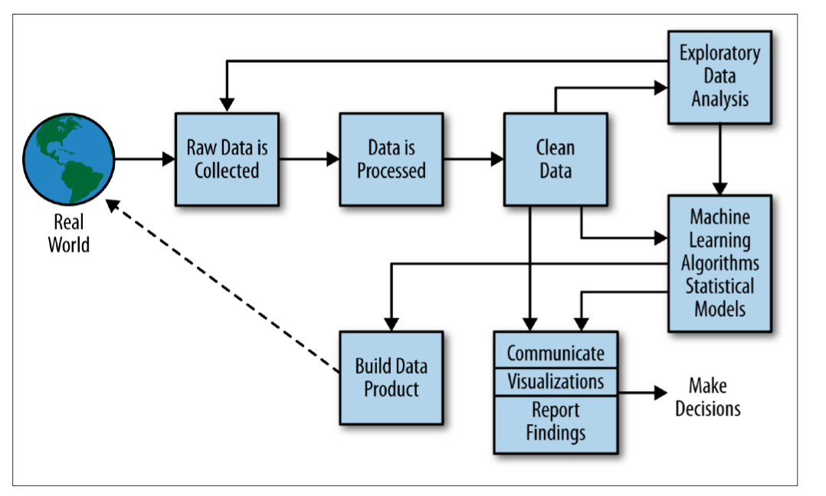
Data Science
Data Science is a combination of collecting, munging, analyzing, visualizing, and communicating
data to answer questions about the world around us
Image Credit: Rachel Schutt & Cathy O’Neil in Doing Data Science: Straight Talk From the Frontline
Notes:
A lot like saying “Full stack developer” Those who know, snicker a bit because it’s doing the job of at least three people: frontend, backend, sysadmin

Slide 5
Data Science Process
A common conception of what all Data Science is. Analysis.
Requires skills Machine Learning, Mathematics, Statistics and Domain Expertise
Image Credit: Rachel Schutt & Cathy O’Neil in Doing Data Science: Straight Talk From the Frontline

Slide 6
Data Science Process
Data Science actually spends 80% of the time doing
Requires skills in Computer Science, Domain Expertise, and Mathematics
Image Credit: Rachel Schutt & Cathy O’Neil in Doing Data Science: Straight Talk From the Frontline
Image Credit: Rachel Schutt & Cathy O’Neil in Doing Data Science: Straight Talk From the Frontline

Slide 7
Data Science Process
Data Science tends to struggle when communicating and delivering actionable insights
Requires skills in Communication, Data Visualization, Domain Expertise, Statistics

Slide 8
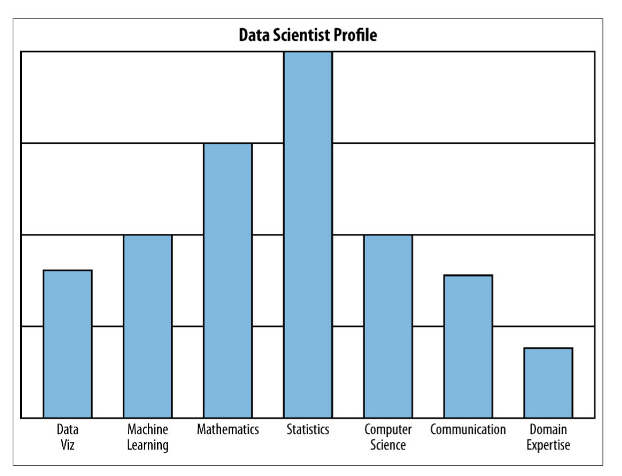
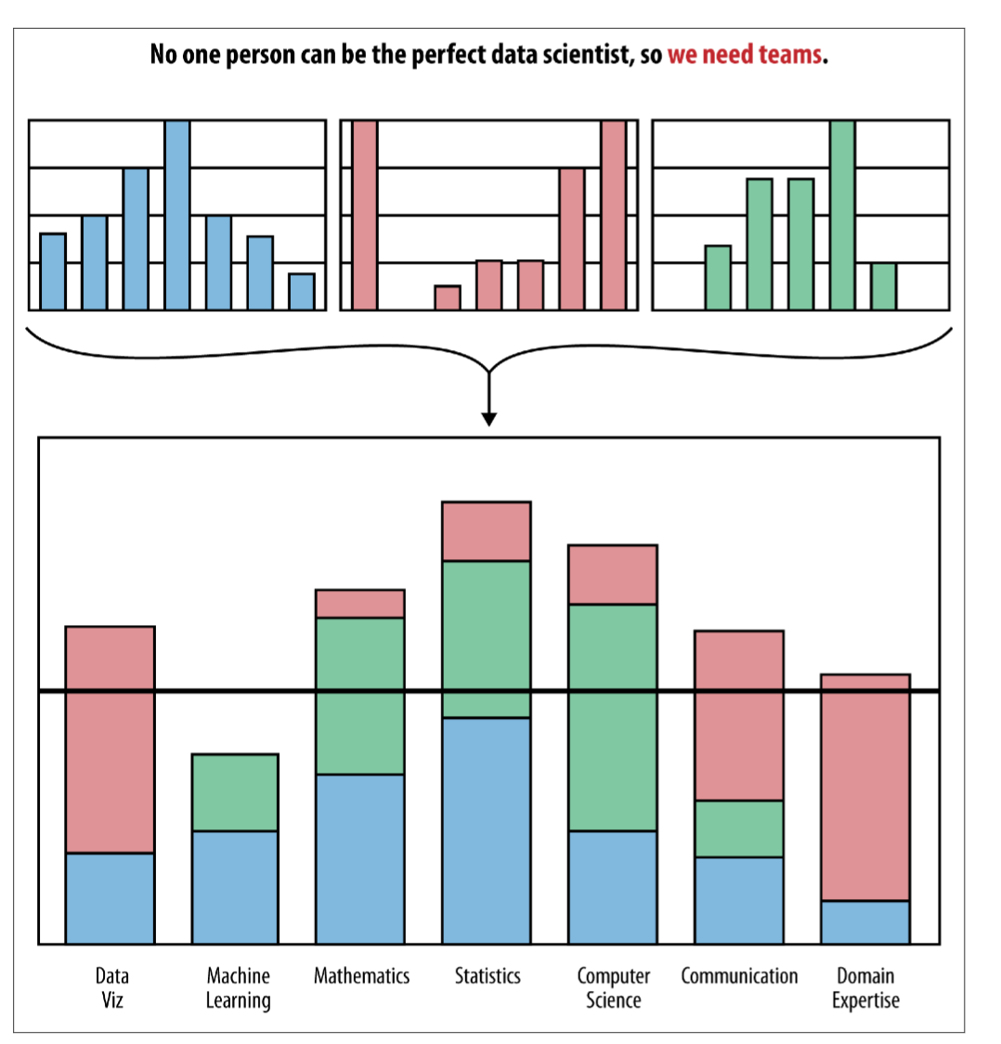
Data Science
Data Science really incorporates many different jobs and skills
Being a “data scientist” is very much like being a “full stack developer”
At Teem we now have a teem of 8 people with a variety of specialties - Exploring the data, creating a data warehouse, data pipeline creation, visualization creation
Image Credit: Rachel Schutt & Cathy O’Neil in Doing Data Science: Straight Talk From the Frontline
Notes:
A lot like saying “Full stack developer” Those who know, snicker a bit because it’s doing the job of at least three people: frontend, backend, sysadmin

Slide 9
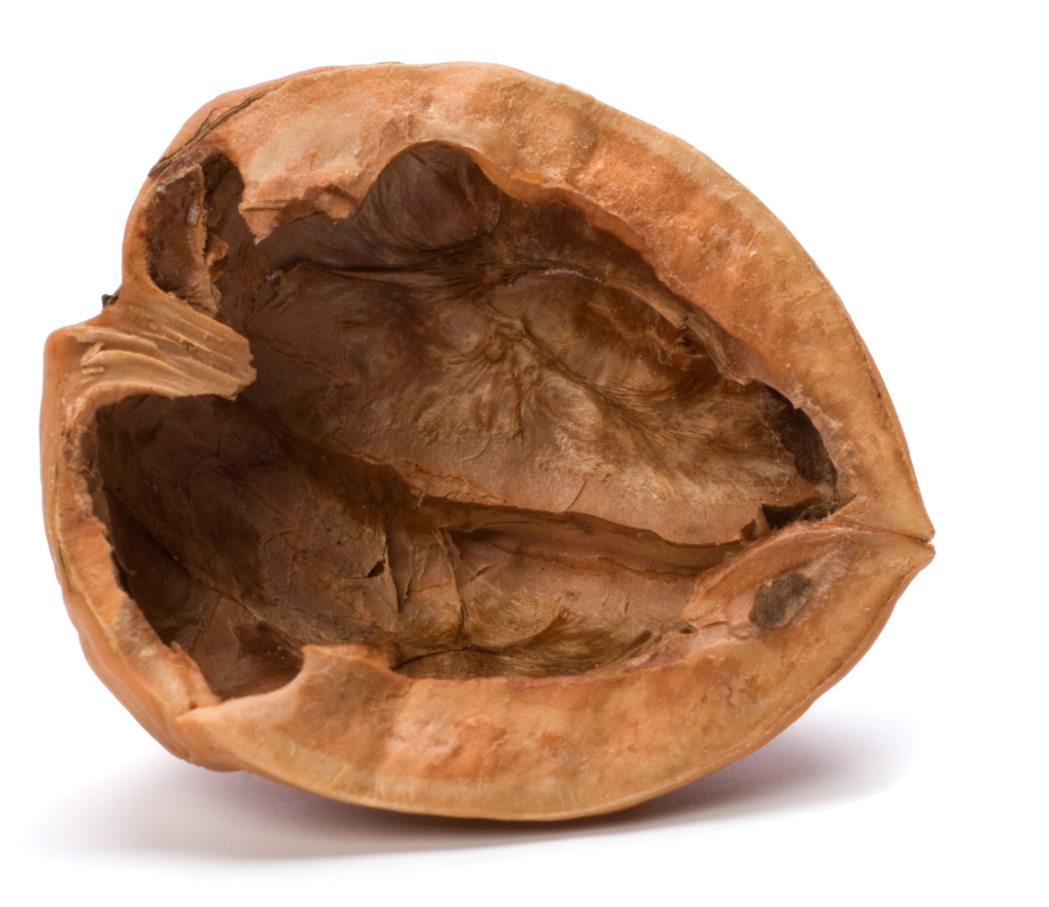
Data Science

Slide 10
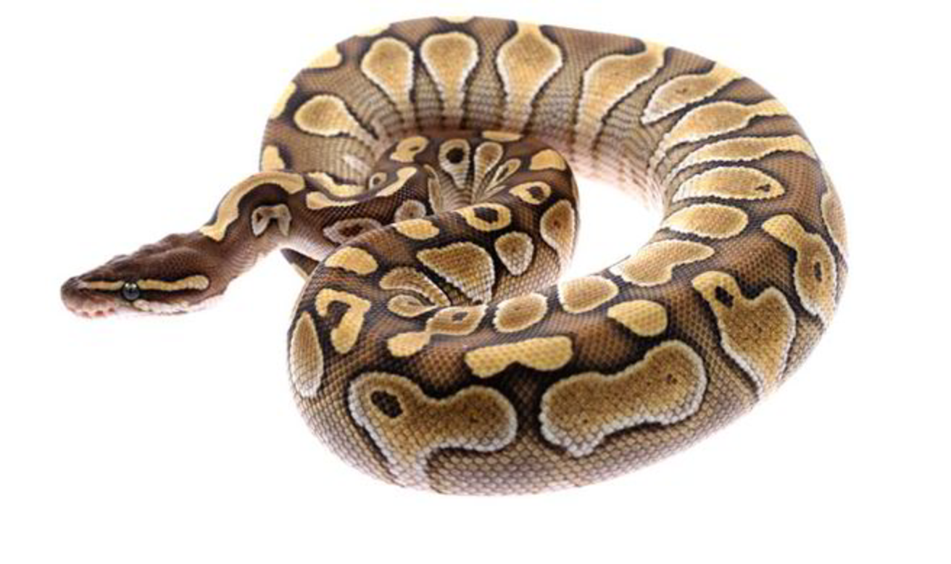
So what about Python?

Slide 11
So what about Python?
Python can be used during all stages of the data science process
Python reduces development time
Python can perform efficiently through c/c++ and fortran extensions
Python has a LARGE community
Python/Notebooks
Python
Talend/Python/AWS Stuff/Spark
Python/Spark
Python/Talend/Redshift
Python/Javascript
At Teem we use several technologies at each step but Python is a primary tool

Slide 12

Ok, So what about this Pandas thing?

Slide 13
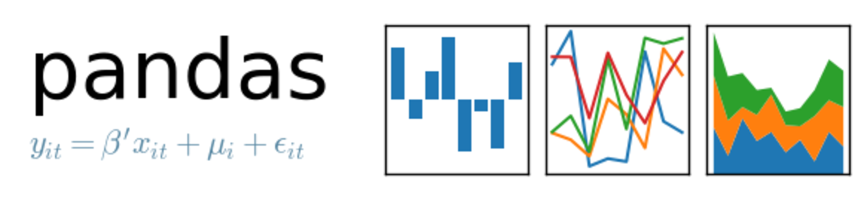
The Pandas thing
Pandas is a Python library that adds a DataFrame data structure to make the data science process easier
Pandas is performant, with many of it’s core functionalities exported to C
Pandas plays well with other Python modeling and visualization libraries

Slide 14
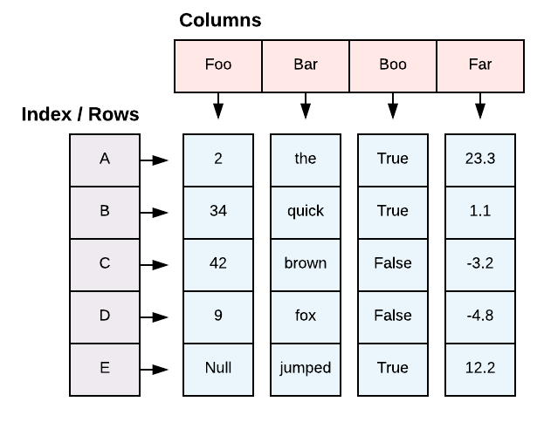
The DataFrame
DataFrame is the primary data structure in the Pandas library
Made popular in R, many languages are now adopting a similar data structure including Spark

Slide 15
The DataFrame
DataFrames are a tabular data structure with rows and columns and metadata about them
Matrix like
Each column can have different type
Row and column metadata
Size mutable: insert and delete columns and rows
Credit: Wes McKinney, PyCon 2012

Slide 16
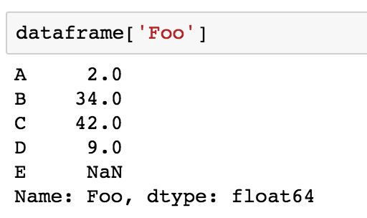
The DataFrame
A Pandas DataFrame can be thought of as a Python dictionary of numpy arrays
Aside: One column of a DataFrame is called a Series
Credit: Wes McKinney, PyCon 2012

Slide 17
Aside : The Series
Name
Subclass of numpy.ndarray
Data: any dtype
Index labels
Duplicate row indexes are possible (but some functions require unique)
Credit: Wes McKinney, PyCon 2012

Slide 18
The Index
Every axis has an index
Used to implement:
Fast lookups
Data alignment and join operations
Each axis index is a self-contained data structure
Credit: Wes McKinney, PyCon 2012

Slide 19
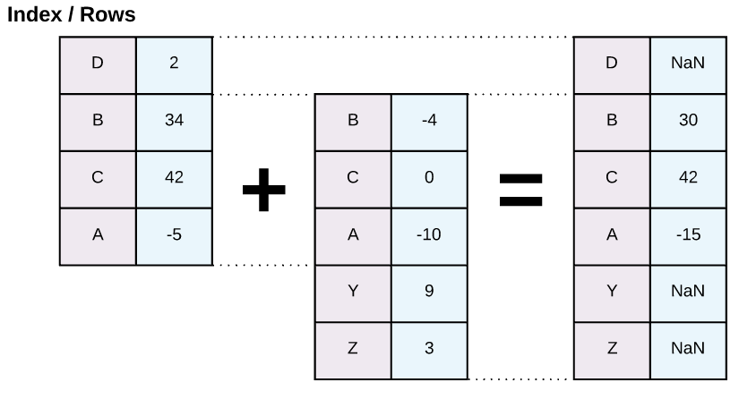
The Index : Data Alignment
The Index is used for data alignment when doing join actions (like + - * / )
Does an “Outer” join by default
Credit: Wes McKinney, PyCon 2012

Slide 20
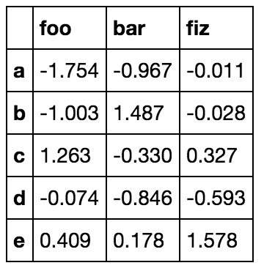
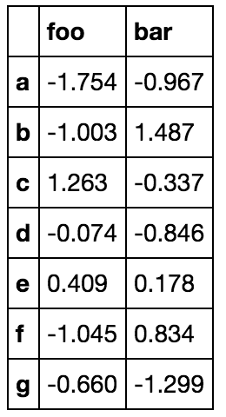
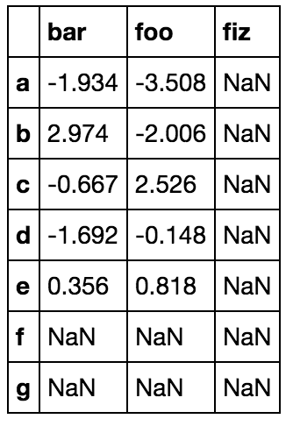


The Index : Data Alignment
DataFrame joins / align on both axes
Technically the columns are an index – which allows Pandas to have an N-dim data structure
Credit: Wes McKinney, PyCon 2012

Slide 21
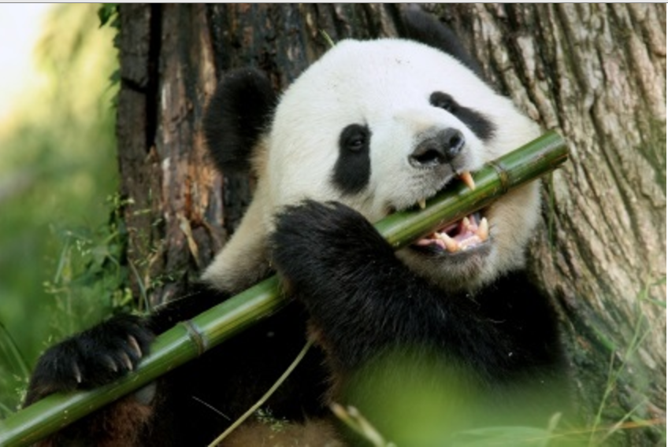
Data Science with Pandas

Slide 22
Data Science with Pandas
Pandas has tools which can help across all steps of data science
IO and Format Conversions
Descriptive Info
Mutability
Filtering
Flexible Accessing
Handling Missing Values
Statistics and Math
Groupby Aggregation
Data Alignment
Data Visualization
Date Time Handling
Library Compatibility

Slide 23
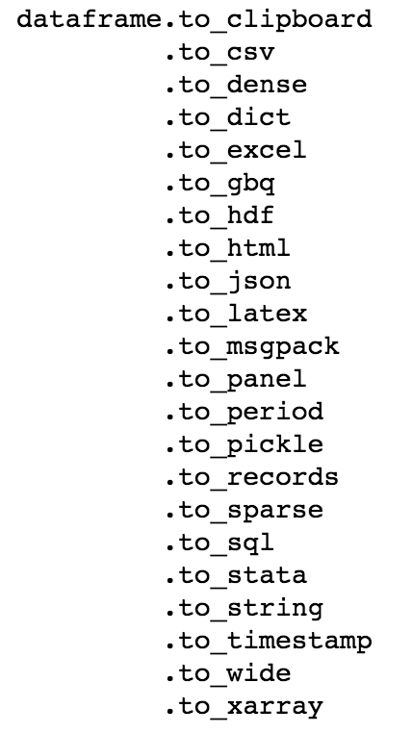
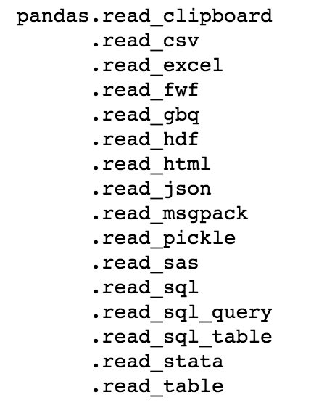
IO and Format Conversion
These will construct a Pandas DataFrame from the specified storage format
These will output a Pandas DataFrame to a specified format

Slide 24
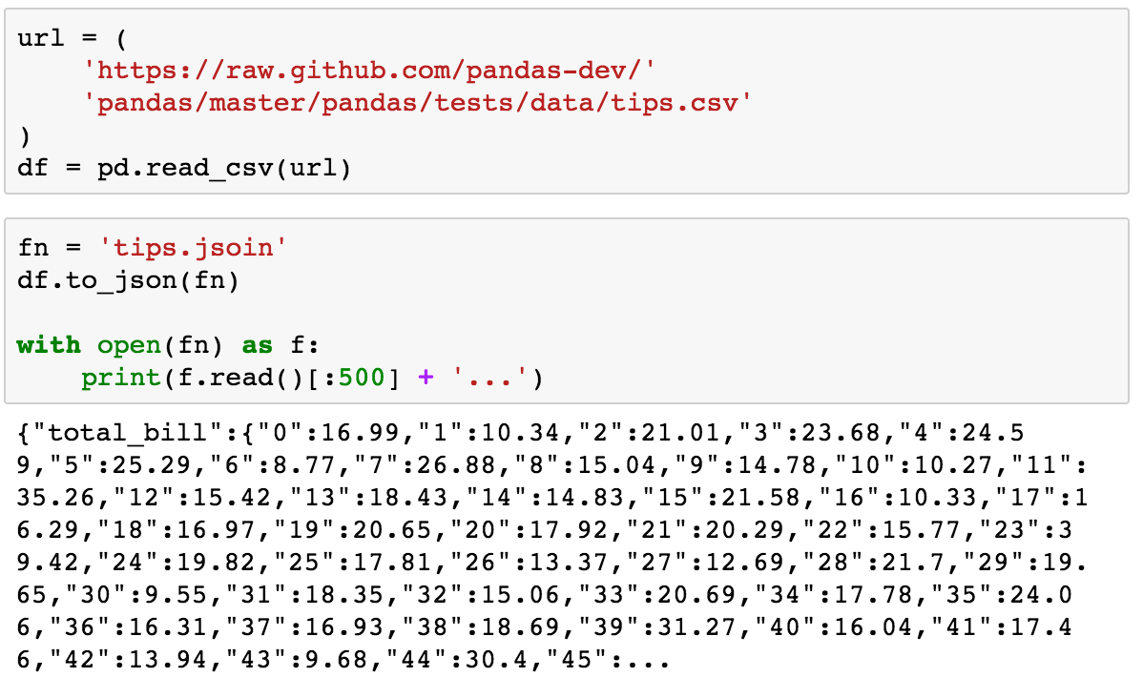
IO and Format Conversion

Slide 25
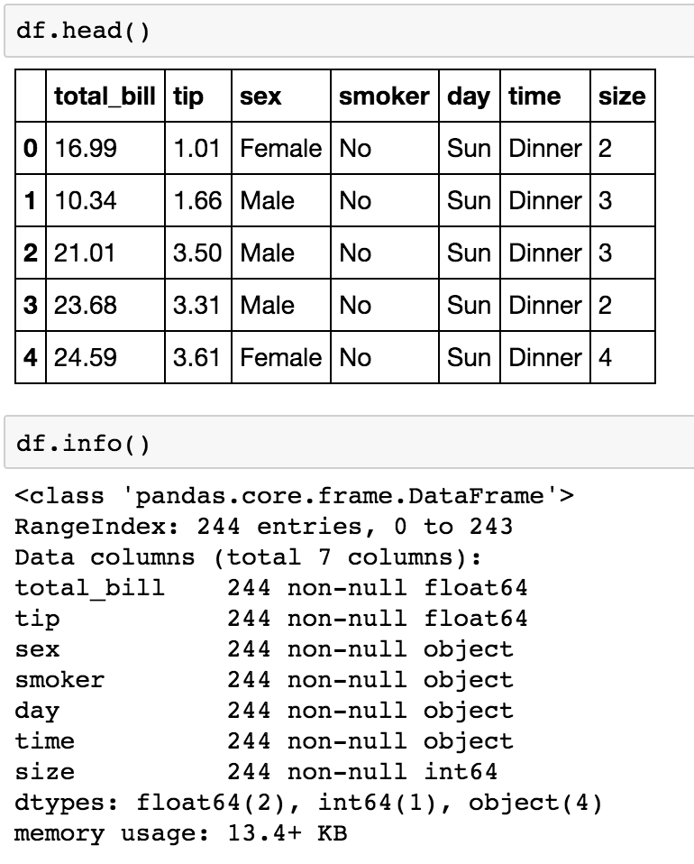
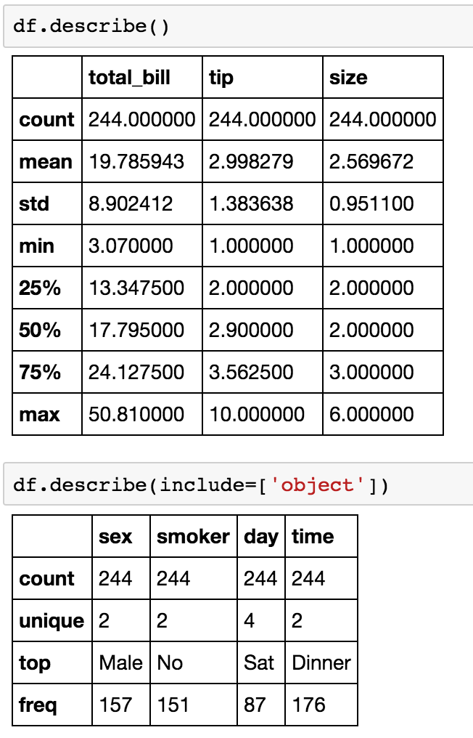
Descriptive Tools

Slide 26
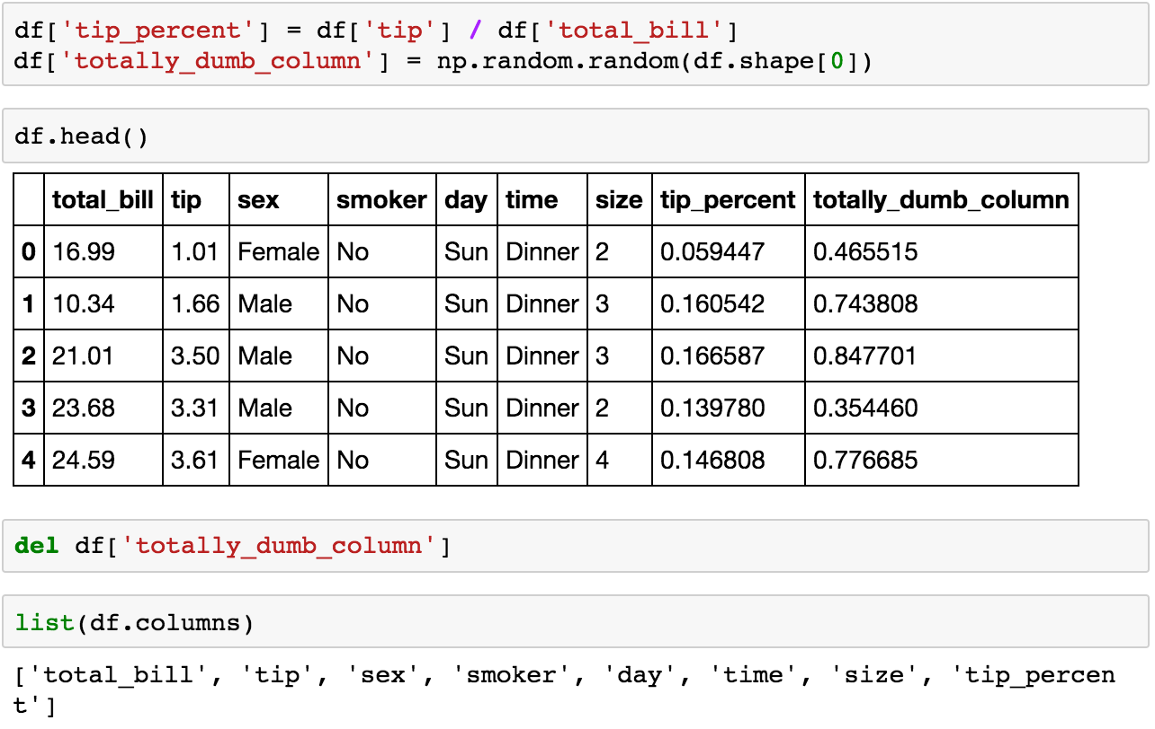
Mutability

Slide 27
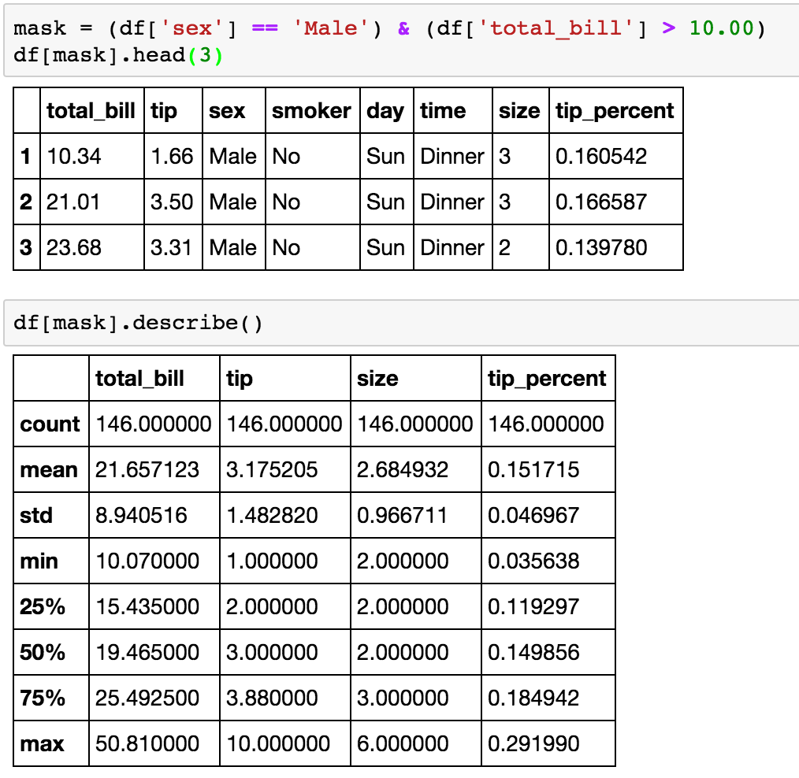
Filtering

Slide 28
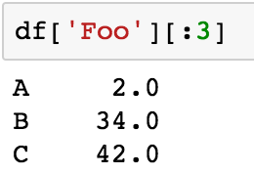
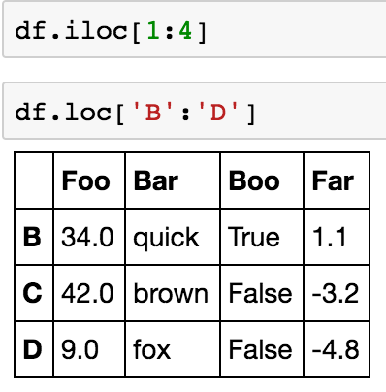
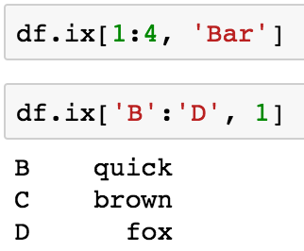
Flexible Accessing
[ ], iloc, loc, ix exist to access the data using integer position and labels

Slide 29
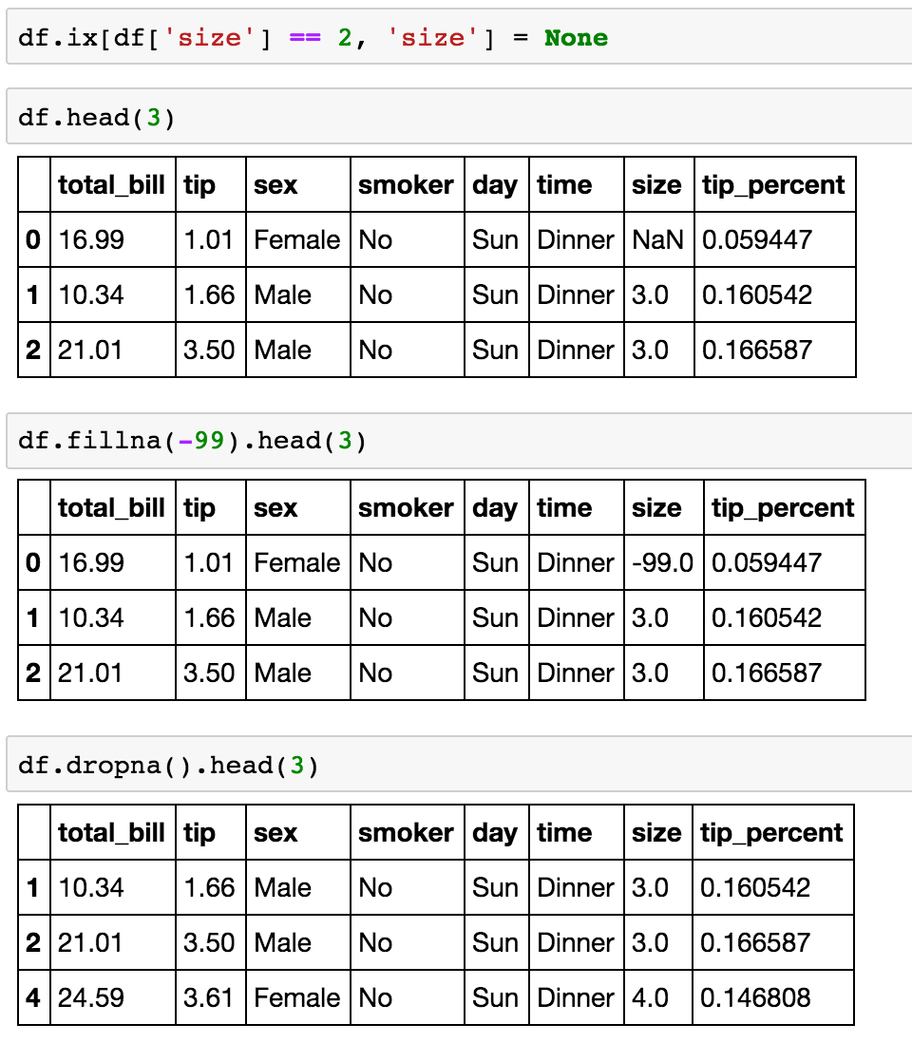
Handling Missing Values

Slide 30
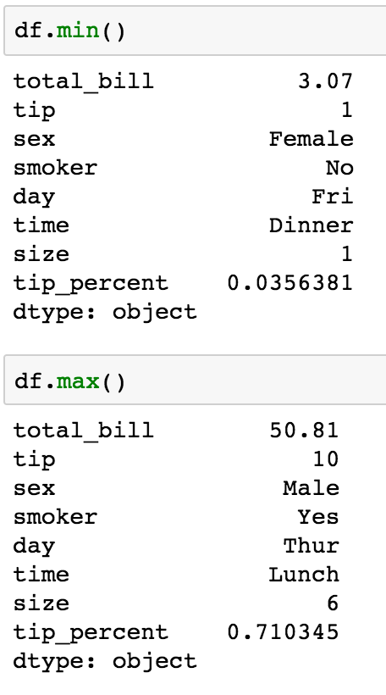
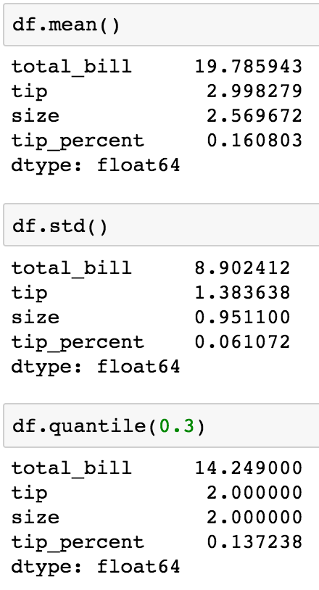
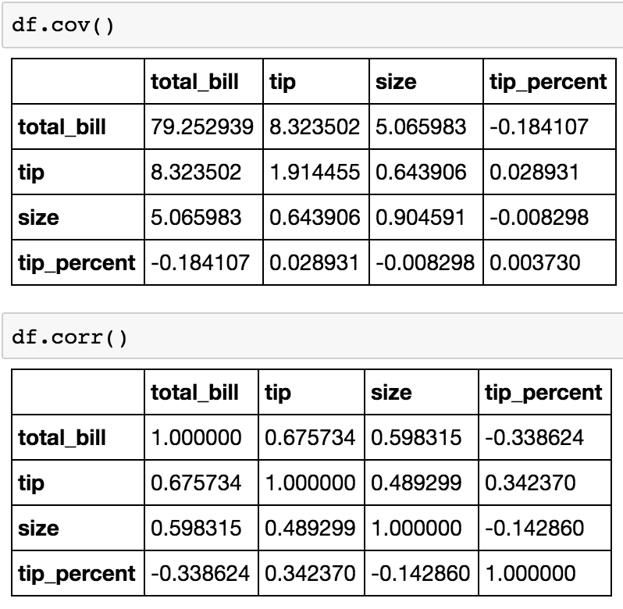
Statistics and Math
.min
.max
.sum
.diff
.abs
.add
.sub
.product
.pow
.rank
.mean
.mode
.std
.skew
.quantile
.median
.corr
.cov

Slide 31
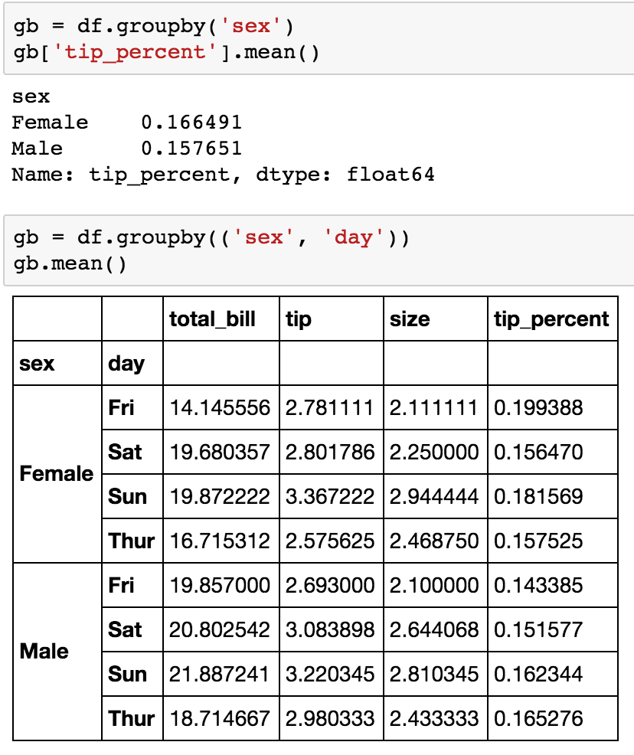
Groupby Aggregation

Slide 32
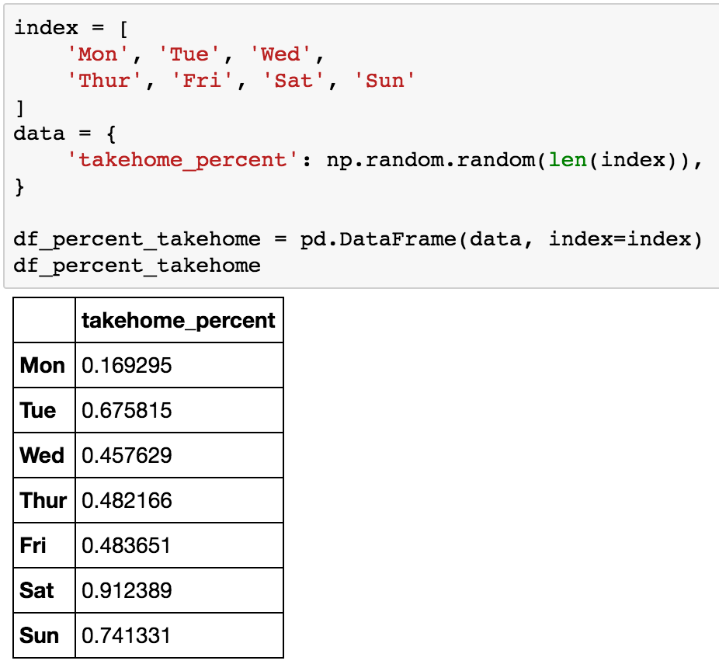
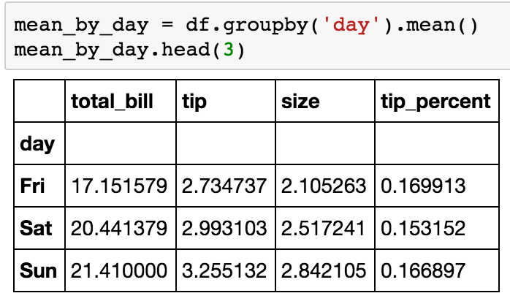
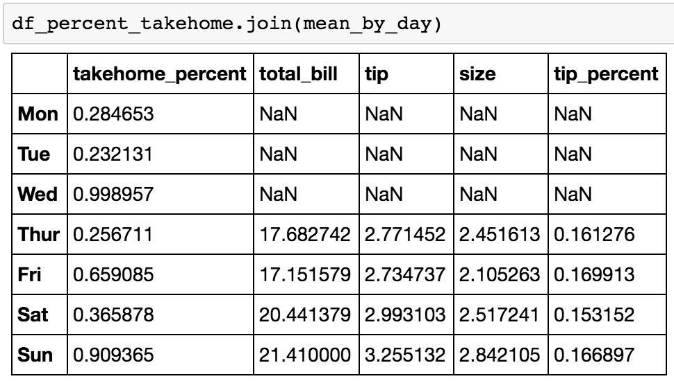
Data Alignment

Slide 33
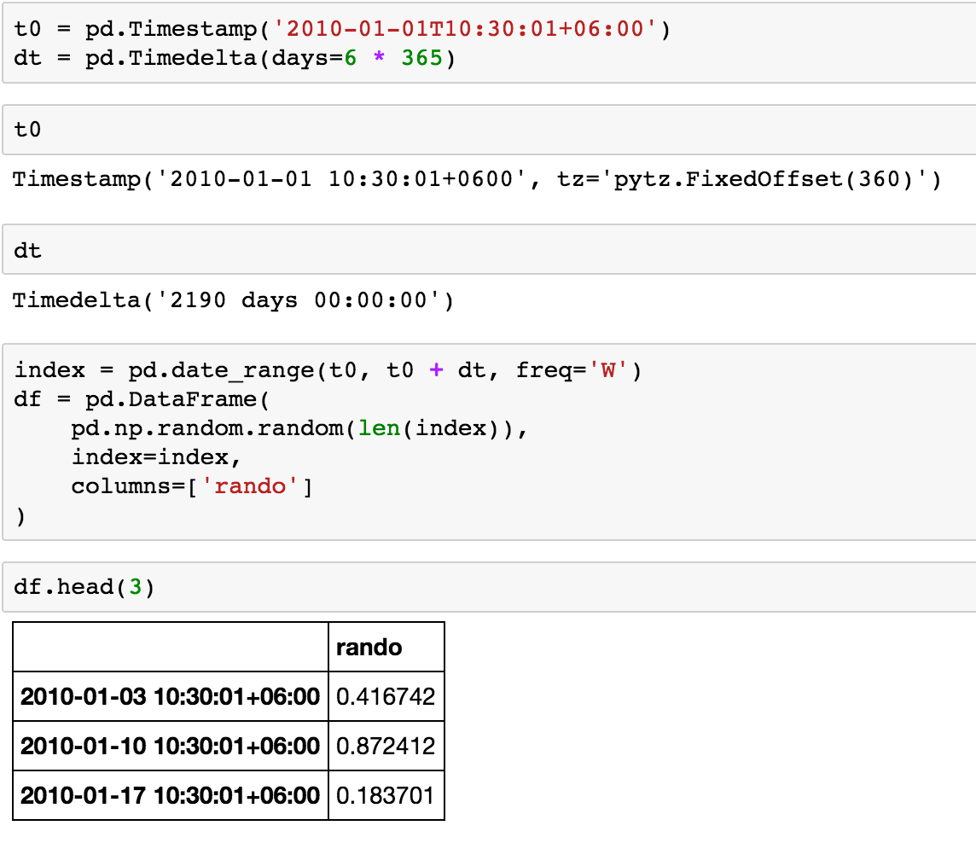
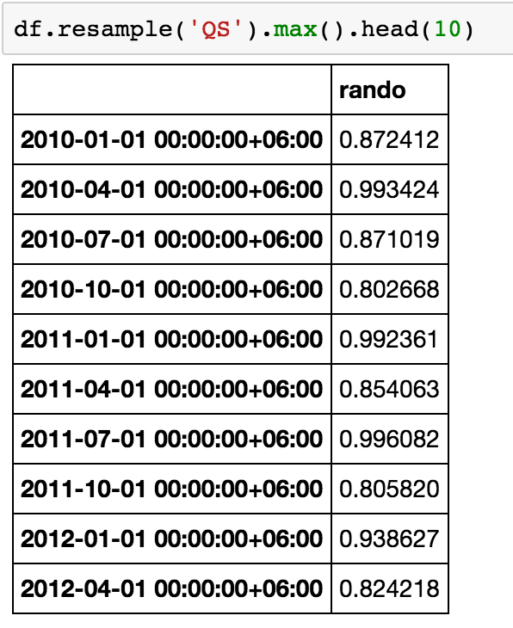
Date Time Handling

Slide 34
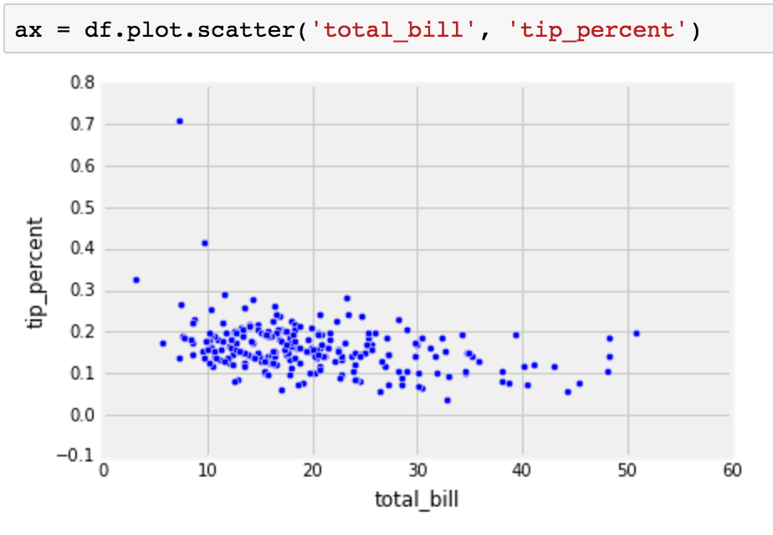
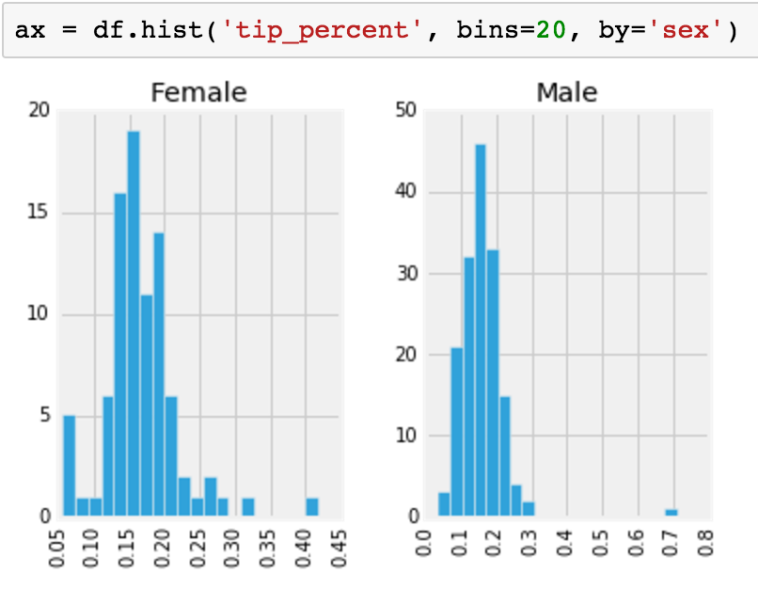
Data Visualization
For more check out http://pandas.pydata.org/pandas-docs/version/0.18.1/visualization.html

Slide 35







Library Compatibility
www.python-excel.org

Slide 36


Data Science with Pandas
Pandas has tools which can help across all steps of data science
IO and Format Conversions
Descriptive Info
Mutability
Filtering
Flexible Accessing
Handling Missing Values
Statistics and Math
Groupby Aggregation
Data Alignment
Data Visualization
Date Time Handling
Library Compatibility

Slide 37
In Summary…
Data Science roughly describes the multi-disciplinary process of using data to answering questions about the world around us
Python is a powerful language for data science and the library Pandas provides a powerful DataFrame data structure which aids data science’s quest to answer questions
gregersen.dylan@gmail.com
astrodsg.github.io

Slide 38

Thank You!
Data Science roughly describes the multi-disciplinary process of using data to answering questions about the world around us
Python is a powerful language for data science and the library Pandas provides a powerful DataFrame data structure which aids data science’s quest to answer questions
gregersen.dylan@gmail.com
astrodsg.github.io

Slide 39
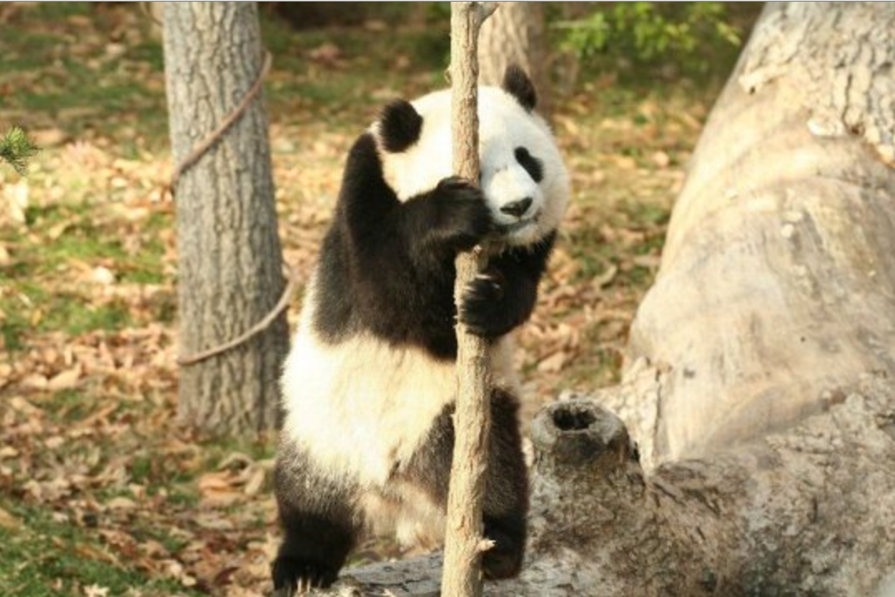
Extra Slides this way…

Slide 40
Links and References
Doing Data Science : Straight Talk From the Frontline
http://pandas.pydata.org/pandas-docs/stable/tutorials.html
https://pythonprogramming.net/python-pandas-data-analysis/
https://www.youtube.com/watch?v=yzIMircGU5I&list=PL5-da3qGB5ICCsgW1MxlZ0Hq8LL5U3u9y
https://github.com/brandon-rhodes/pycon-pandas-tutorial
http://pandas.pydata.org/talks.html
https://github.com/pandas-dev/pandas/blob/master/doc/cheatsheet/Pandas_Cheat_Sheet.pdf

Slide 41
Creating a DataFrame

Slide 42
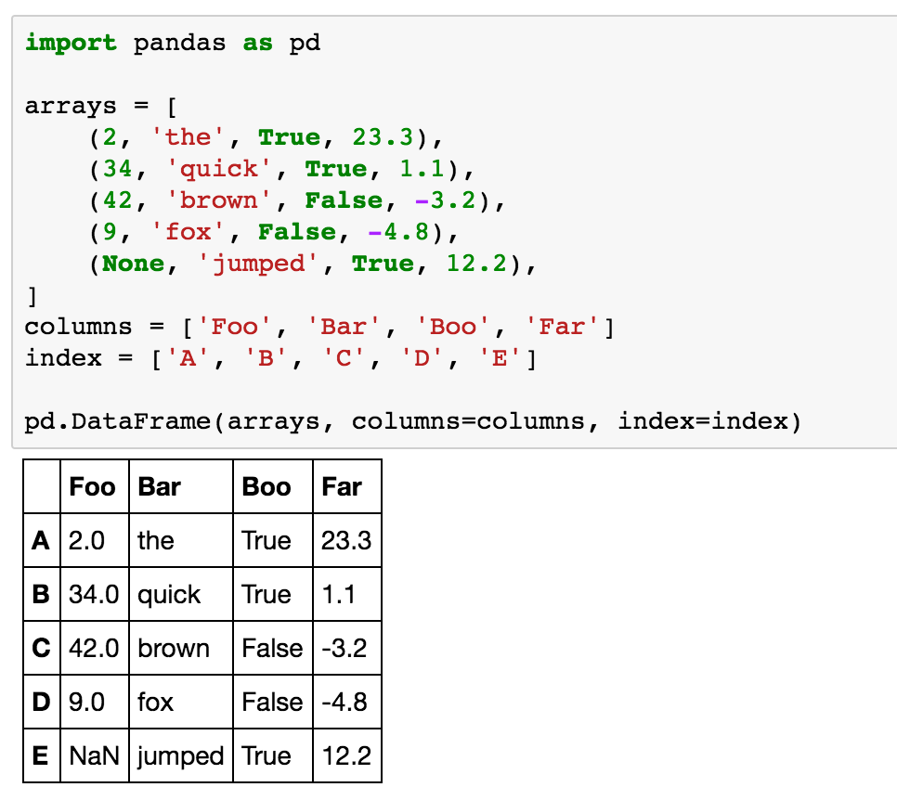
The DataFrame : Creation

Slide 43
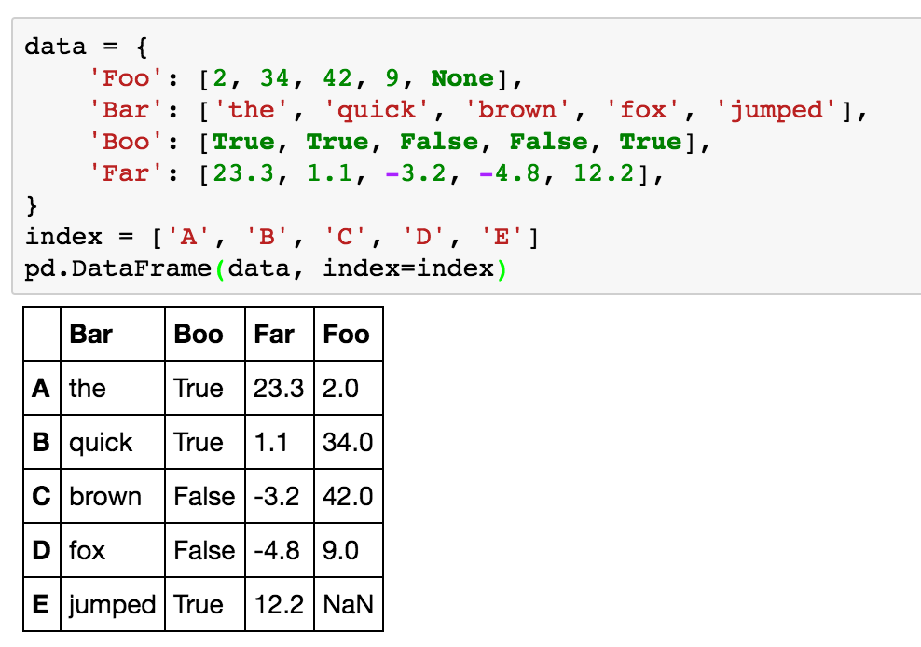
The DataFrame : Creation

Slide 44
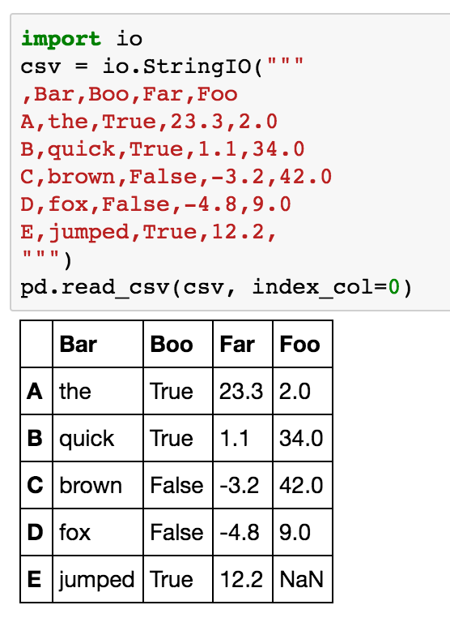
The DataFrame : Creation

Slide 45
Accessing a DataFrame

Slide 46
The DataFrame : Access Methods
df[:-3]
df.loc[‘A’:’B’]
df.iloc[:-0, :-0]
df.iloc[:-1]
df.ix[‘d’:, :-0]
df.ix[:,0]
df[‘name’][10]
df[‘age’]

Slide 47
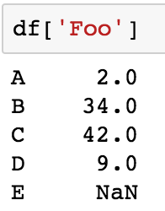
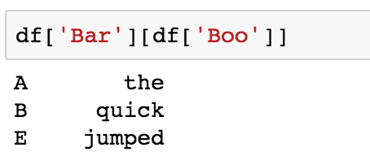
The DataFrame : []
Standard getitem method for accessing the data frame
Pandas does a lot of guessing. Either experiment or look at the source code
Below you shows accessing by a column like a dictionary
For help on slicing magic
https://stackoverflow.com/questions/509211/explain-pythons-slice-notation
For more on boolean array indexing see Numpy
https://docs.scipy.org/doc/numpy/user/basics.indexing.html

Slide 48
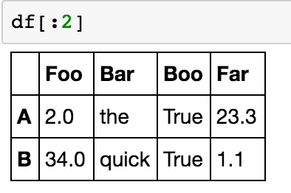
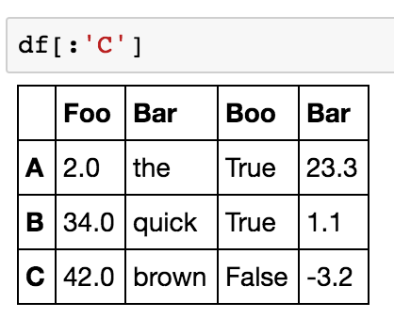
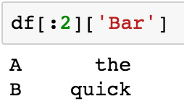
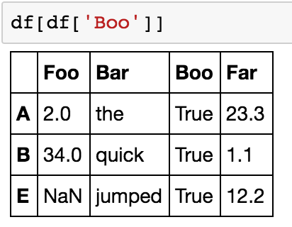
The DataFrame : []
Accessing the rows
Note: with integers it is exclusive and with labels it is inculsive of the end value

Slide 49
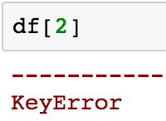
The DataFrame : []
But what if you want to access the 3rd row?
You can’t with [] because it’s looking for 2 as a column

Slide 50
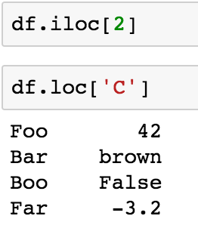
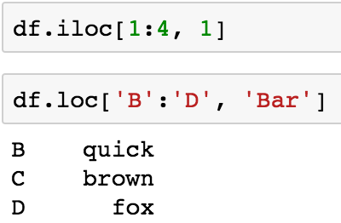

The DataFrame : loc and iloc
iloc is for accessing by integer & integers are exclusive of the end value
loc is for accessing by label & labels are inclusive of the end value

Slide 51



The DataFrame : ix
ix is for accessing by integer and label
integers are exclusive of the end value
labels are inclusive of the end value

Slide 52
Other

Slide 53

Data Science
Image Credit: Drew Conway via Doing Data Science: Straight Talk From the Frontline
Notes:
A lot like saying “Full stack developer” Those who know, snicker a bit because it’s doing the job of at least three people: frontend, backend, sysadmin

Slide 54
Library Compatibility

